Slide 1
The Cork District Winery Project
Team 3
Alfredo Vela
Jesse Cummins
Logan Brooke
Travis Melcher

Slide 2
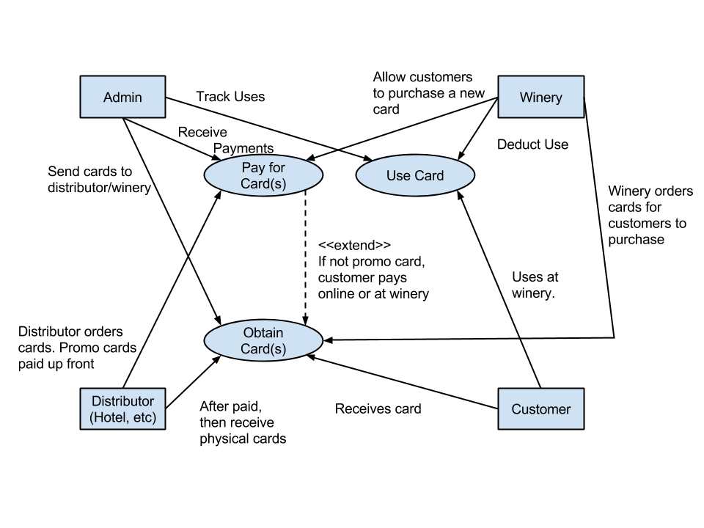
UML Diagram

Slide 3
Four components
I. Database
II. Website
III. Software
IV. Tasting Cards

Slide 4
I. Database
1. How is the database accessed?
2. What information should be stored on the database?
3. What database will be used?
4. How will the database be organized?

Slide 5
I. Database
[A] The database will be accessed by an administrator through the website. (1)
[B] Once the customer purchases tastings on the website and inputs their specific information the customer information will be read into the database. (1)
[C] At the winery the card will be read by a card reader and the database will be involved to look up the number of tastings then deduct one tasting from the card and save it back into the database. (1)
[D] The database must store card information (card ID, #tastings, registration number). (2)
[E] The database will store customer information ( customer name, customer email, customer contact info). (2)
[F] The database will store information regarding the winery (winery location, winery ID, winery contact info). (2)
[G] The database will store vendor information (vendor location, vendor ID, vendor contact info). (2)
[H] The database will be organized into tables (customer table, winery table, vendor table, brand table). (4)

Slide 6
II. Website
1. Where will the website be hosted?
2. How will the non-customers access their part of the database?
3. What information should be displayed about a users card?
4. How can a user purchase tastings on the website?
5. Who can access the non-customer side of the website?
6. How does the client access the information that he needs?
7. What type of input is valid on the non-customer side of the website?
8. Who can a card be purchased for?

Slide 7
II. Website
[A] The website will be hosted by godaddy and Mike has the specific name for the site. (1)
[B] The administrator will have a unique password to type in to enable administrative features on the website. (2)
[C] The information displayed for the users cards will be the number of tastings they have left on the card. (3)
[D] To purchase tastings on the website the user will enter a visa or mastercard payment and they will get 3 tastings. (4)
[E] The only person that can access non-customer information will be the administrator. (5)
[F] The client will access the information they need by going back to the website and input their log in information. (6)
[G] When the customer access the website they will have a text field to input their card number. (7)
[I] The website will have a register button. (7)

Slide 8
III. Software
1. How does the software interface with the database?
2. How does the software get information from the cards?
3. What happens when a card won't scan?
4. What is used for card purchasing?

Slide 9
III. Software
[A] The software will interface with the database by reading or writing to the database. If data is being input then the software will open the database and write to it. If a card is read or a customer puts in his log in ID then we will the database will open and read how many tasting are left. (1)
[B] The software will get information by scanning or user input. (2)
[C] If a card does not scan then you will be able to input the card information and access the database. (3)
[D] The software will have a browser built in for purchasing from the website. (4)

Slide 10
IV. Tasting Cards
1. When is a card depleted?
2. Where can a card be registered?
3. How is a card scanned?

Slide 11
IV. Tasting Cards
[A] The card will be depleted after 3 tastings. (1)
[B] A card can be registered through the website or preordered. (2)
[C] The cards will be scanned at the winery by either a magnetic scanner or a barcode reader(3)

